Slide 1


Hadeel Moustafa
28/8/2025

Slide 2

Outline
Executive Summary
Introduction
Methodology
Results
Conclusion
Appendix

Slide 3
Executive Summary
Objective
Predict the likelihood of SpaceX Falcon 9 first stage landing successfully.
Optimize launch cost estimation and improve mission planning.
Methodologies
Data Wrangling & EDA
Feature Engineering
Machine Learning Models
Results
Model | Test Accuracy | Key Notes
Logistic Regression | 0.83 | Some false positives
SVM | 0.83 | Best overall performance
Decision Tree | 0.94 | Sensitive to overfitting
KNN | 0.83 | Optimized neighbors and distance

Slide 4
Introduction
Project Background & Context
SpaceX reuses Falcon 9 first stage to reduce launch costs.
Predicting landing success helps optimize missions and costs.
Key Questions
What factors affect landing success?
Can we predict outcomes accurately?
Which model performs best?

Slide 5

Section 1

Slide 6
Methodology
Executive Summary
Data collection methodology:
Describe how data was collected
Perform data wrangling
Describe how data was processed
Perform exploratory data analysis (EDA) using visualization and SQL
Perform interactive visual analytics using Folium and Plotly Dash
Perform predictive analysis using classification models
How to build, tune, evaluate classification models

Slide 7
Data Collection
[SpaceX Website & Public APIs]
|
v
[Download Raw CSV Files]
|
v
[Select Relevant Columns]
|
v
[Data Cleaning & Wrangling]
|
v
[Augment with Geo-Coordinates]
|
v
[Final Dataset for Analysis]
Data Collection Description
Source: Public SpaceX launch records and official SpaceX website
Data Type: Launch details, payload mass, orbit type, launch site, landing outcome
Format: CSV files, structured tabular data
Collection Method:
Downloaded historical launch data
Extracted relevant columns (LaunchSite, PayloadMass, Orbit, Date, Outcome)
Augmented data with geolocation (latitude & longitude) for each launch site
Purpose: Provides a comprehensive dataset to analyze Falcon 9 launch performance and predict first stage landing success

Slide 8
Data Collection – SpaceX API
Present your data collection with SpaceX REST calls using key phrases and flowcharts
Add the GitHub URL of the completed SpaceX API calls notebook (must include completed code cell and outcome cell), as an external reference and peer-review purpose
Place your flowchart of SpaceX API calls here

Slide 9
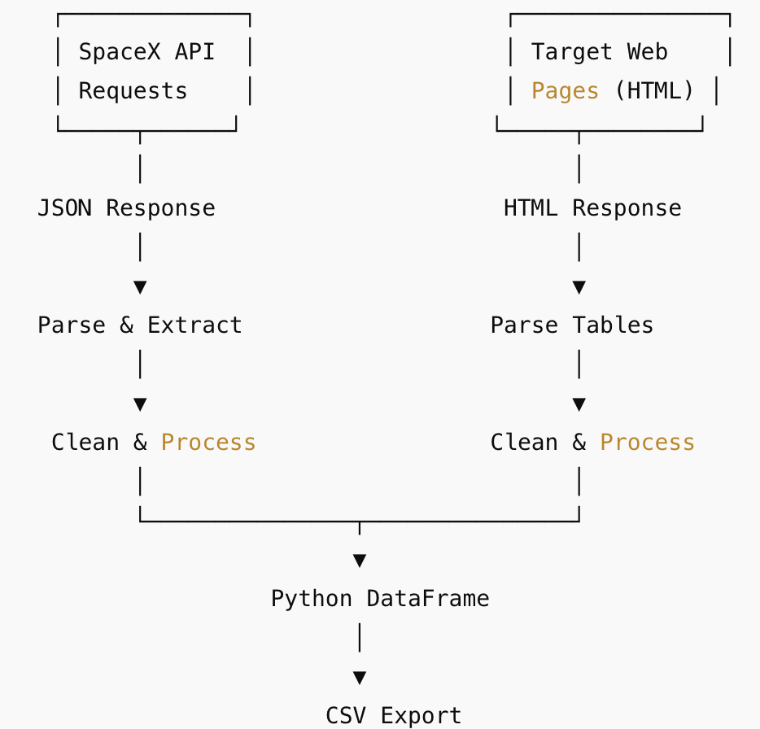
Data Collection - Scraping
Key Phrases / Summary:
REST API Calls: Request → JSON Response → Parse → DataFrame → CSV
Web Scraping: HTTP Request → HTML Response → Parse Tables → Clean Data → DataFrame → CSV
Tools: Python, requests, pandas, BeautifulSoup

Slide 10
Data Wrangling
Key Phrases / Summary:
Load Data: CSV / API / Web Scraped
Inspect & Clean: Check missing values, remove duplicates, fix types
Transform: Create new features, encode categorical variables
Standardize & Normalize: Scale numerical features for modeling
Save Processed Data: Export cleaned datasets for EDA and ML
GitHub: https://github.com/HadeelMous/testrepo.git

Slide 11
EDA with Data Visualization
Flight Number vs Payload: Scatter plot → to see impact of rocket experience and payload on landing success
Launch Site vs Flight Number: Catplot → to visualize site-specific trends over time
Payload vs Launch Site: Catplot → to observe payload distribution by launch site
Orbit Type vs Success Rate: Bar chart → to identify orbits with higher success rates
Flight Number vs Orbit Type: Scatter plot → to check relationship between rocket experience and orbit
Payload vs Orbit Type: Scatter plot → to examine payload effect on orbit success
Yearly Success Rate: Line chart → to analyze temporal trends in landing success

Slide 12
EDA with SQL
Key Points / SQL Queries:
Count launches by site: SELECT LaunchSite, COUNT(*) FROM spacex_df GROUP BY LaunchSite; → Identify busiest launch sites
Count launches by orbit type: SELECT Orbit, COUNT(*) FROM spacex_df GROUP BY Orbit; → Determine orbit frequency
Landing outcomes by orbit: SELECT Orbit, Outcome, COUNT(*) FROM spacex_df GROUP BY Orbit, Outcome; → Compare success/failure by orbit
Payload mass statistics: SELECT Orbit, AVG(PayloadMass), MIN(PayloadMass), MAX(PayloadMass) FROM spacex_df GROUP BY Orbit; → Assess payload distribution
Yearly success rates: SELECT EXTRACT(YEAR FROM Date) AS Year, AVG(Class) FROM spacex_df GROUP BY Year; → Track temporal trends in landings

Slide 13
Build an Interactive Map with Folium
Objects Added:
Markers & Circles: Show launch sites and outcomes
Marker Clusters: Reduce clutter for multiple launches
Lines: Show distances to coastlines, cities, railways, highways
MousePosition: Explore coordinates interactively
Purpose: Visualize launch site locations, outcomes, and proximities

Slide 14
Build a Dashboard with Plotly Dash
Plots/Interactions Added:
Line & Bar Charts: Show success trends by year, launch site, orbit type
Dropdowns & Filters: Select payload, orbit, and launch site
Hover & Click Interactions: Display detailed launch info
Purpose: Explore patterns in launch outcomes and identify key factors for success

Slide 15
Predictive Analysis (Classification)
Model Development Process:
Build Models: Logistic Regression, SVM, Decision Tree, KNN
Evaluate Models: Train/test split, confusion matrix, accuracy score
Tune Hyperparameters: GridSearchCV with cross-validation
Select Best Model: Compare test accuracies and confusion matrices
Flowchart:
Data → Preprocessing → Train/Test Split → Model Training → Hyperparameter Tuning → Evaluation → Best Model

Slide 16
Results
EDA: Flight number, payload, launch site & orbit vs. success → scatter/bar/line charts
Interactive Maps & Dashboards: Folium markers & clusters, proximity lines, Plotly filters
Predictive Analysis: Logistic Regression, SVM, Decision Tree, KNN → best model selected

Slide 17

Section 2

Slide 18
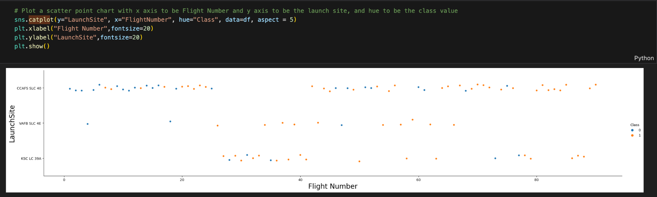
Flight Number vs. Launch Site
Clusters of successful landings appear on the higher flight numbers, while failures concentrate in lower flight numbers.

Slide 19
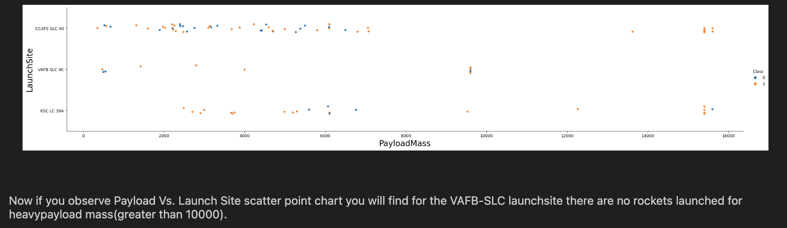
Payload vs. Launch Site

Slide 20
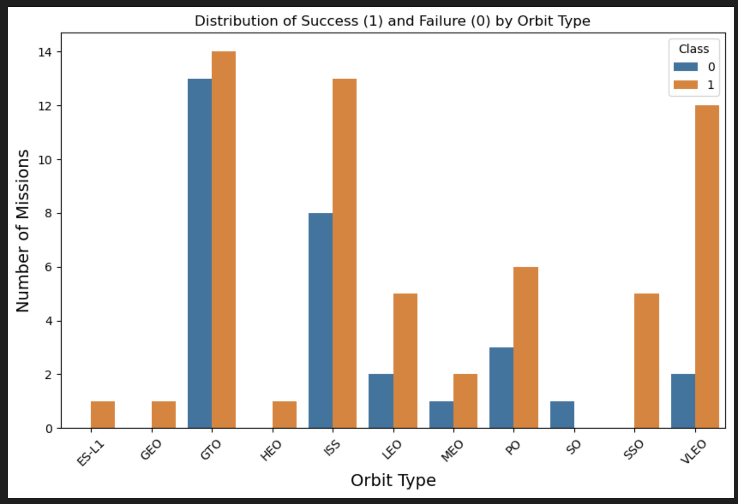
Success Rate vs. Orbit Type
Explanation of Patterns
High success orbits:
SSO: Only successful launches.
VLEO: Also high success rate.
Mixed orbits:
GTO and ISS: Many failures and successes, so more risky.

Slide 21
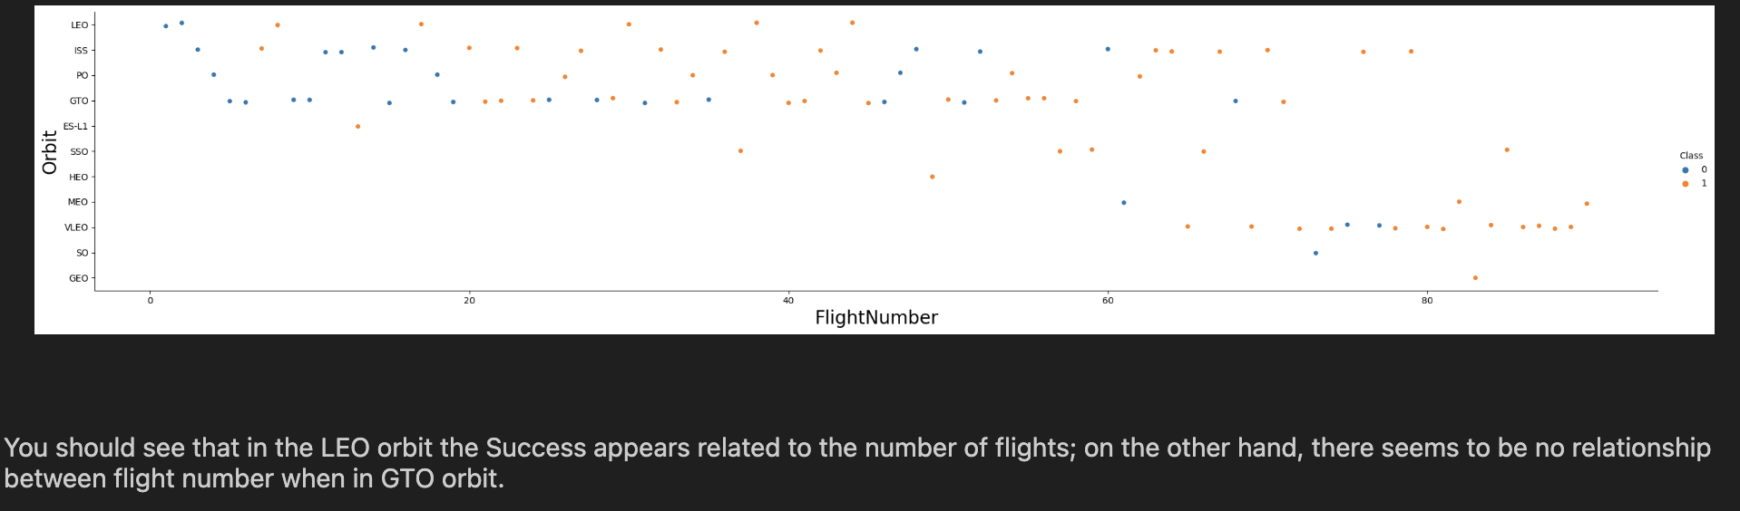
Flight Number vs. Orbit Type

Slide 22
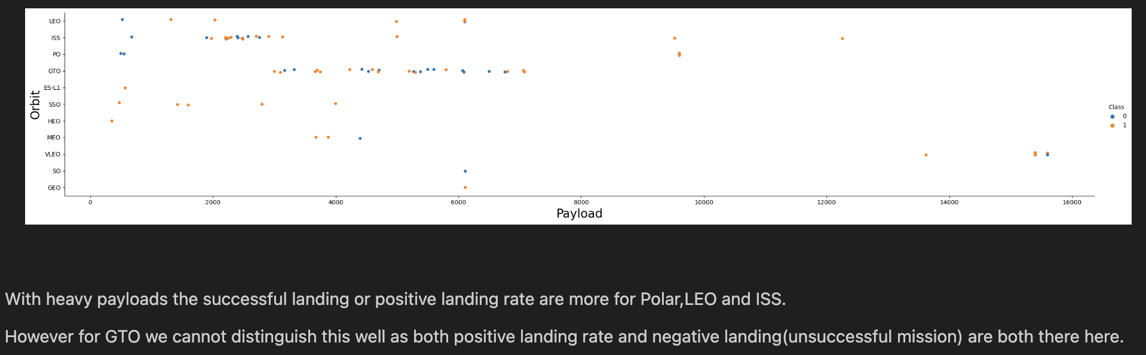
Payload vs. Orbit Type

Slide 23
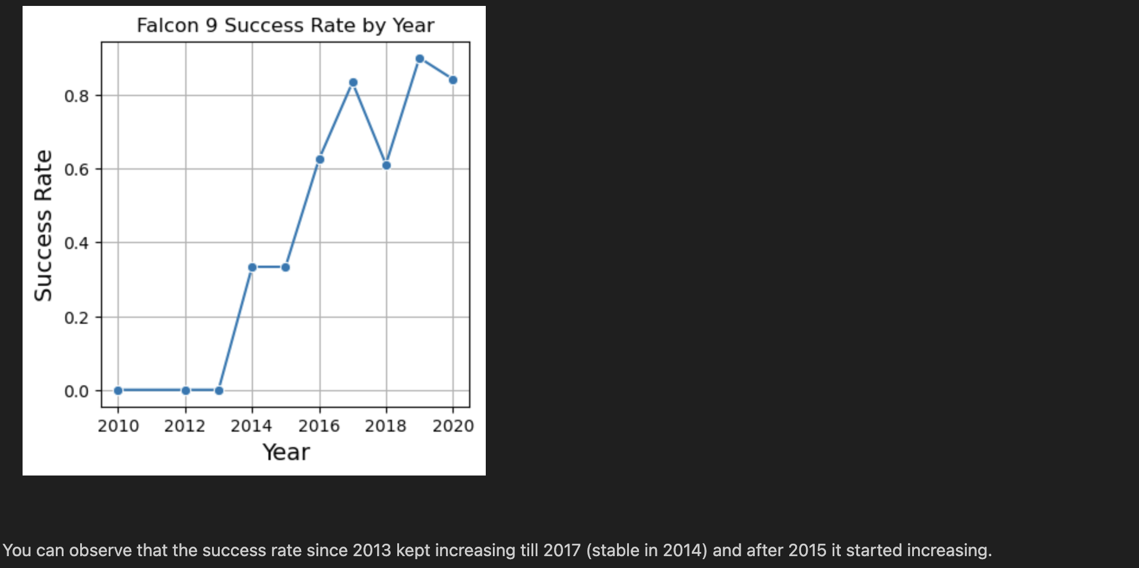
Launch Success Yearly Trend

Slide 24
All Launch Site Names
The names of the unique launch sites
['CCAFS LC-40' 'VAFB SLC-4E' 'KSC LC-39A' 'CCAFS SLC-40']
The dataset contains four unique SpaceX launch sites.
These are the locations from which Falcon 9 rockets have been launched.
Identifying unique launch sites is important for analyzing launch success rates by location.

Slide 25
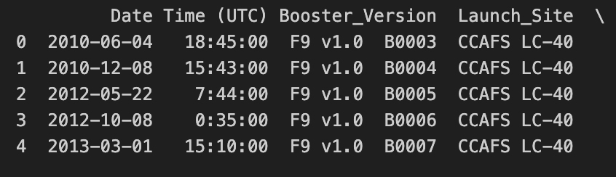
Launch Site Names Begin with 'CCA'
The query selects the first 5 launch records from sites that start with "CCA", includes only CCAFS LC-40. This helps focus analysis on launches from Cape Canaveral.

Slide 26
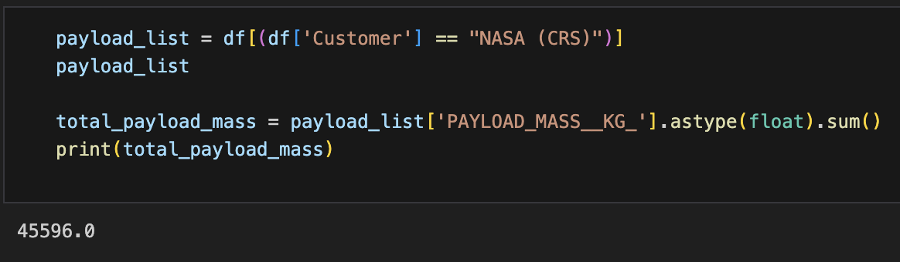
Total Payload Mass
The query sums the PayloadMass for all launches from NASA sites, giving the total payload carried by boosters from NASA.

Slide 27
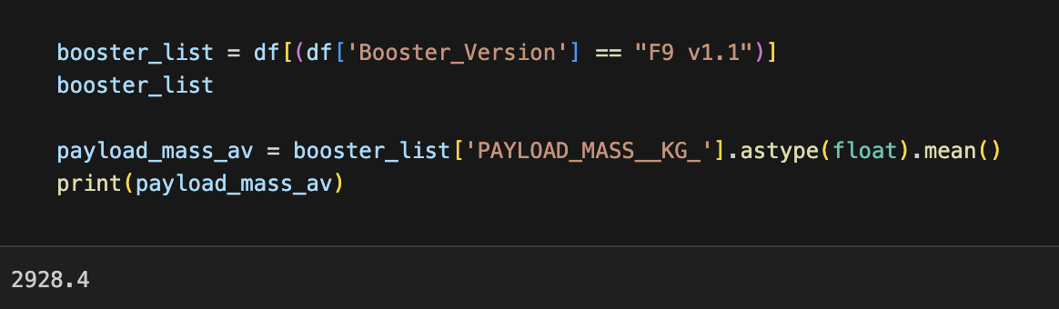
Average Payload Mass by F9 v1.1
We filtered launches for the booster version F9 v1.1 and calculated the mean PayloadMass to find the average payload carried by that booster version.

Slide 28
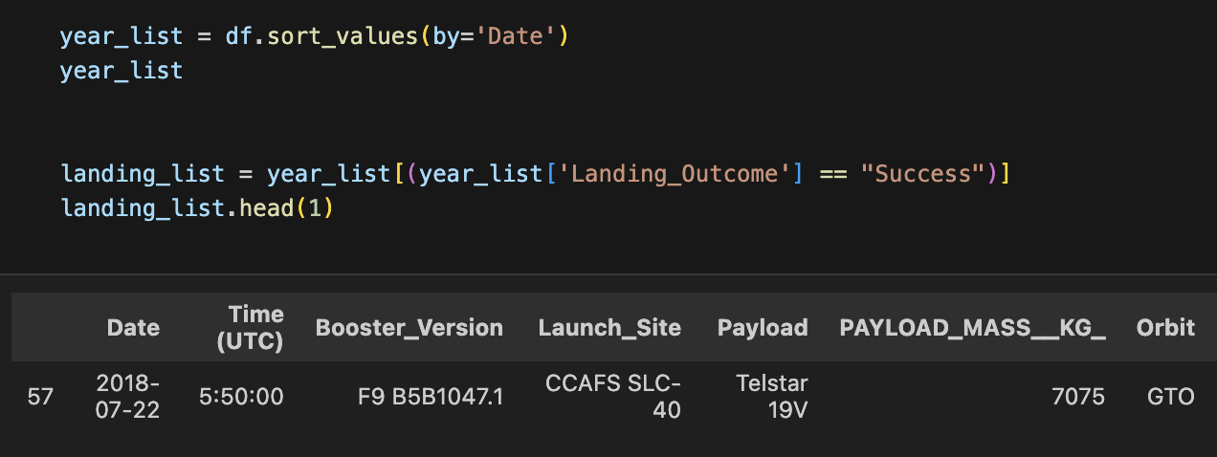
First Successful Ground Landing Date
We sorted the dataset by launch date, filtered for successful landings (Landing_Outcome = 'Success'), and extracted the earliest record to determine the first successful landing. This approach allows us to identify the date of the initial successful Falcon 9 landing.

Slide 29
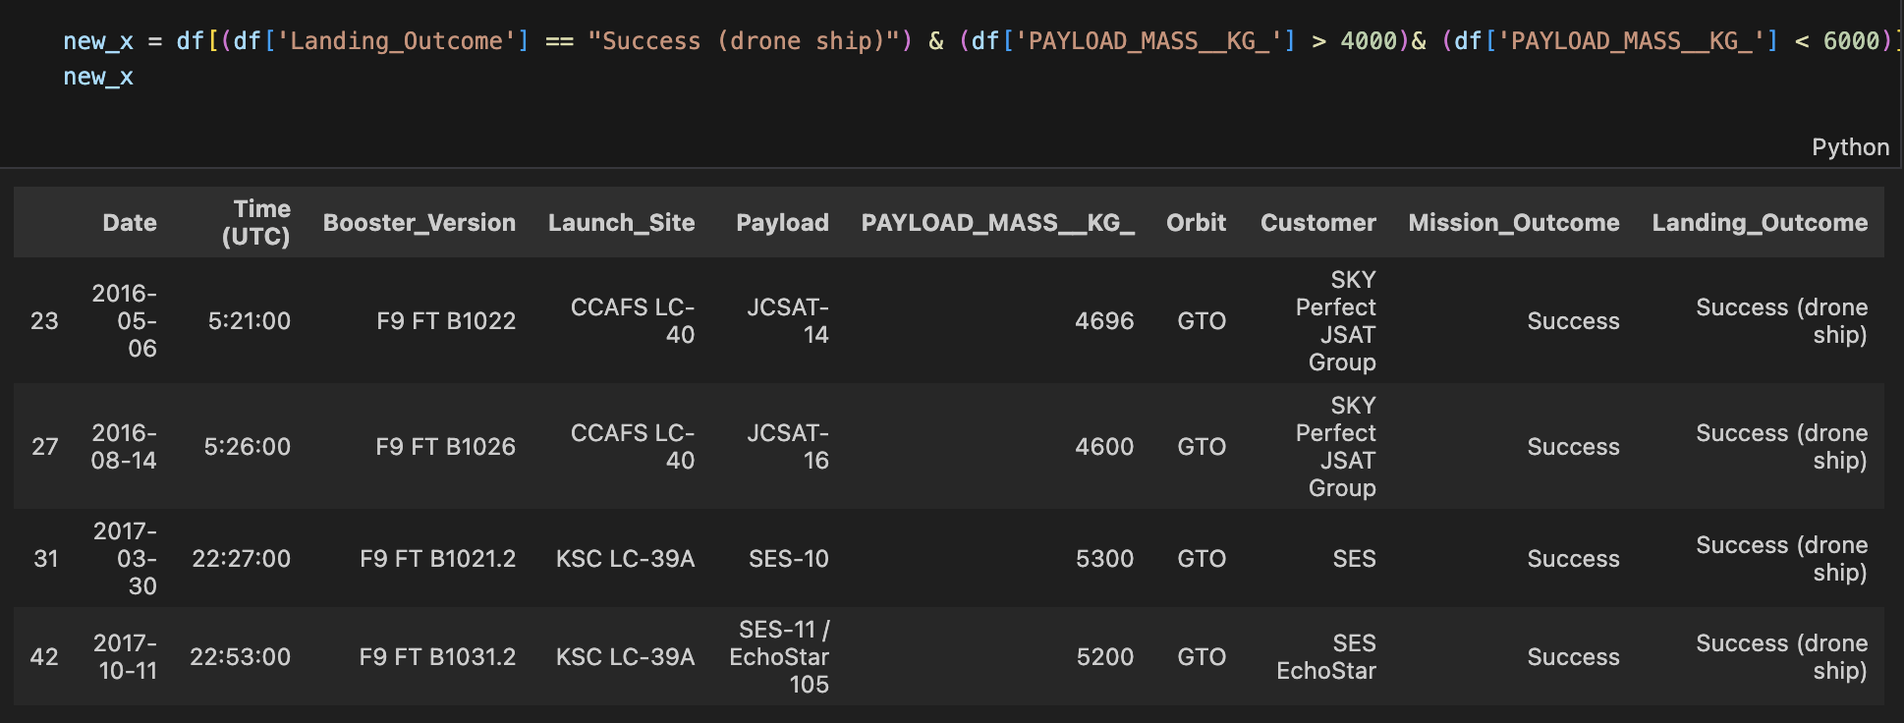
Successful Drone Ship Landing with Payload between 4000 and 6000
It helps identify which boosters are more reliable for mid-weight launches.

Slide 30
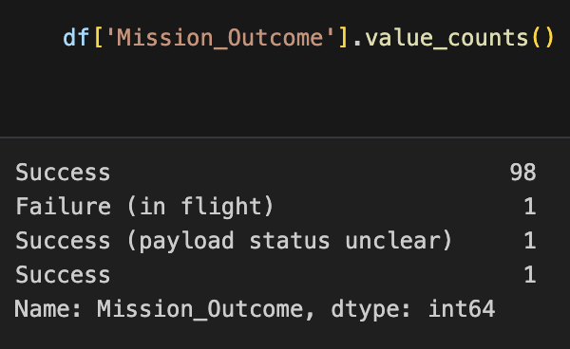
Total Number of Successful and Failure Mission Outcomes
The result shows the total number of successful missions compared to failed missions. This gives a quick snapshot of SpaceX’s historical launch performance and reliability trends.

Slide 31
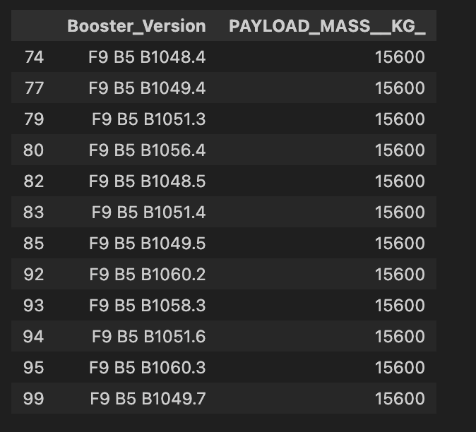
Boosters Carried Maximum Payload
This query gives us the booster name(s) that carried the heaviest payload ever launched by SpaceX. It highlights which booster version was capable of handling the largest mission payload.

Slide 32
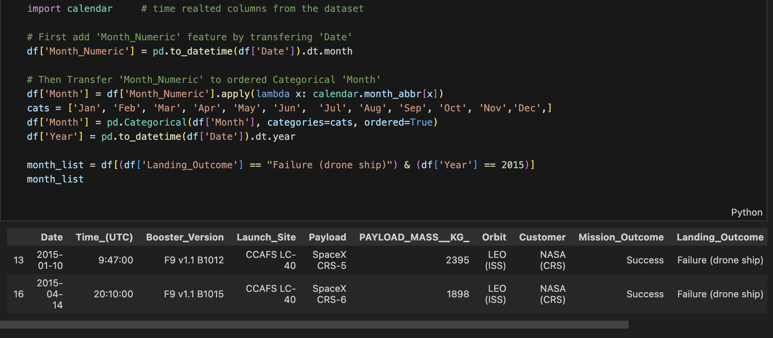
2015 Launch Records
This query shows the failed drone ship landings in 2015, along with the booster versions that attempted them and the launch sites. It highlights how SpaceX was still experimenting and learning in early Falcon 9 missions before consistently achieving success.

Slide 33
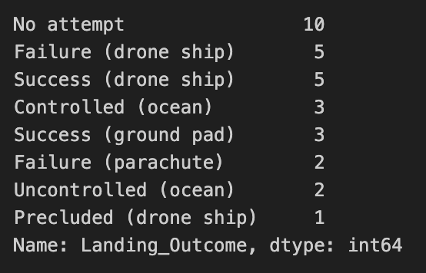
Rank Landing Outcomes Between 2010-06-04 and 2017-03-20
This query summarizes all landing outcomes during the early Falcon 9 development phase.
The ranking reveals which outcomes (e.g., Failure (drone ship) or Success (ground pad)) occurred most often.

Slide 34

Section 3

Slide 35
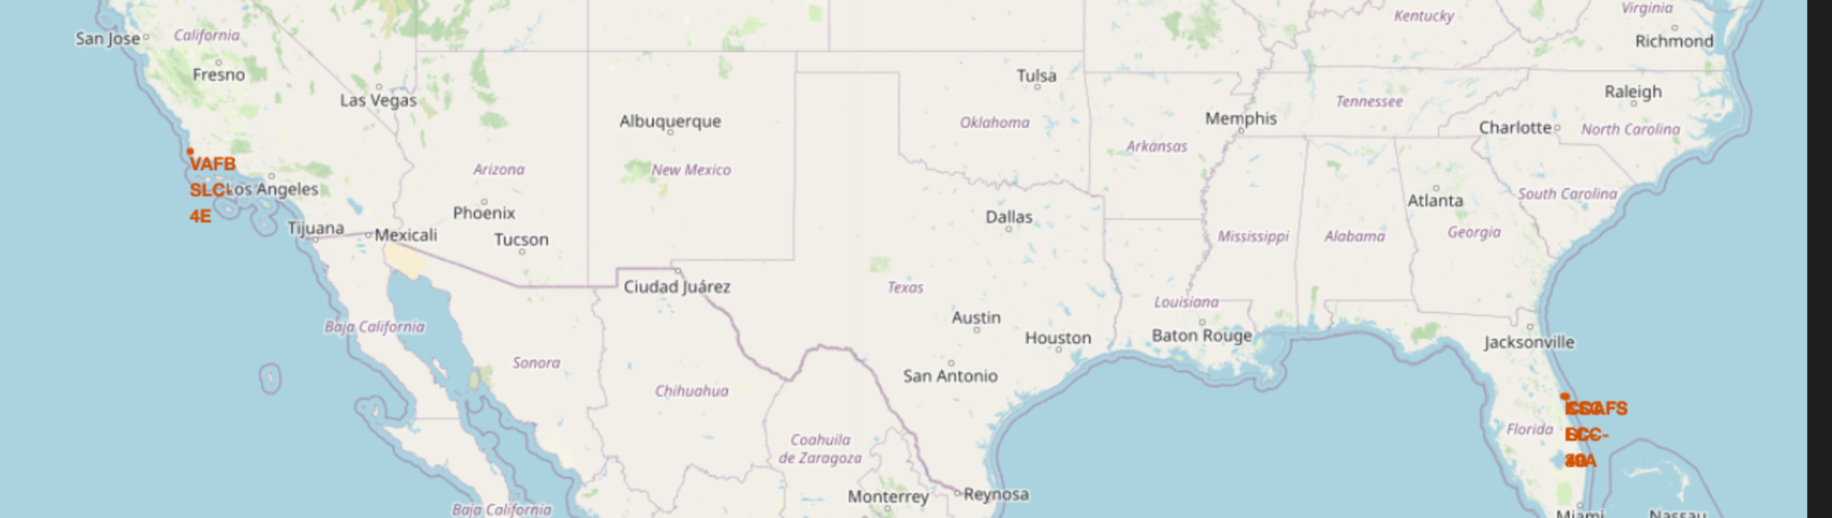
Global Distribution of SpaceX Launch Sites
Map shows all SpaceX Falcon 9 launch sites.
Two sites in Florida (KSC LC-39).
One site in California (VAFB SLC-4E).
One site in Virgiana Beach (CCAFS SLC-40, CCAFS LC-40).

Slide 36
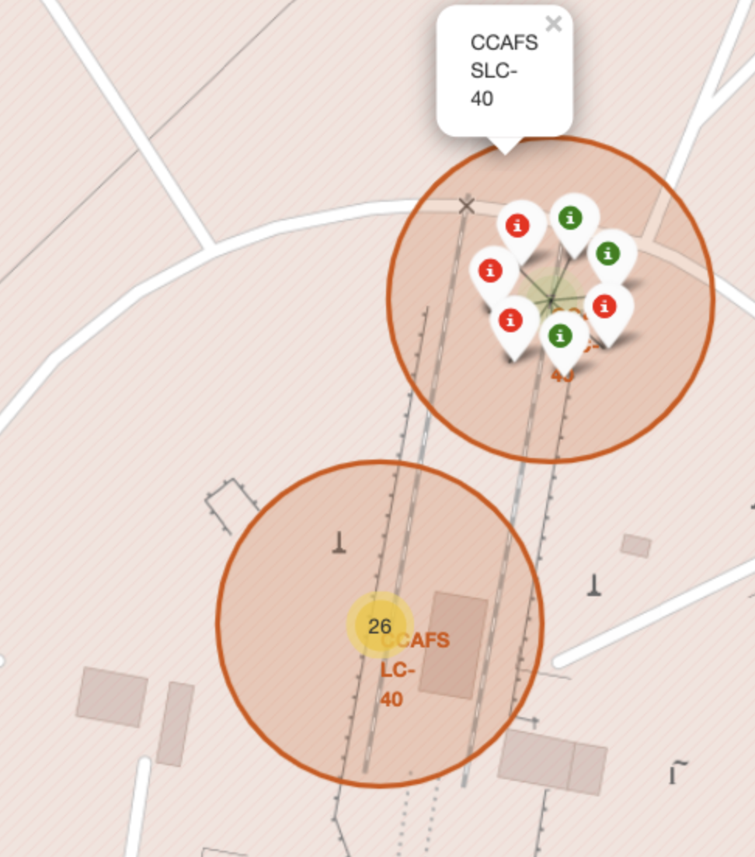
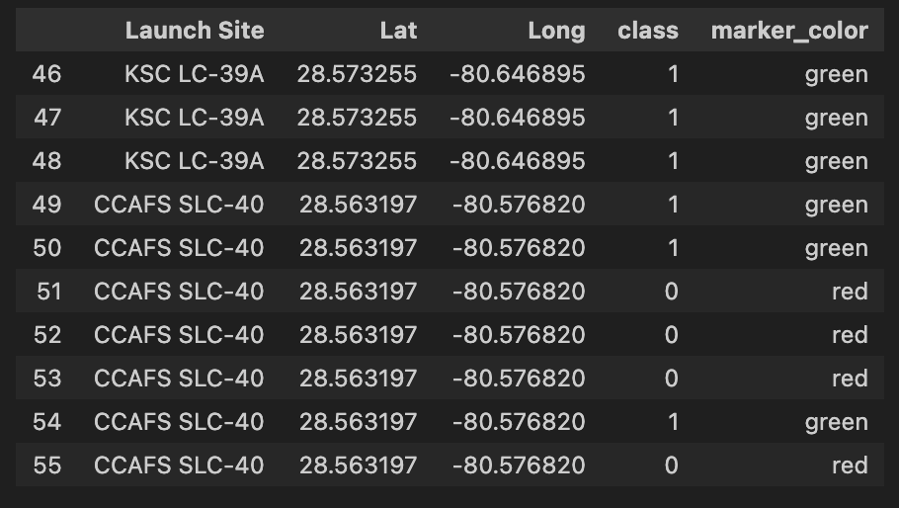
Launch Outcomes by Site (Success vs. Failure)

Slide 37
Launch Site Proximities and Distances
Replace <Folium map screenshot 3> title with an appropriate title
Explore the generated folium map and show the screenshot of a selected launch site to its proximities such as railway, highway, coastline, with distance calculated and displayed
Explain the important elements and findings on the screenshot

Slide 38

Section 4

Slide 39
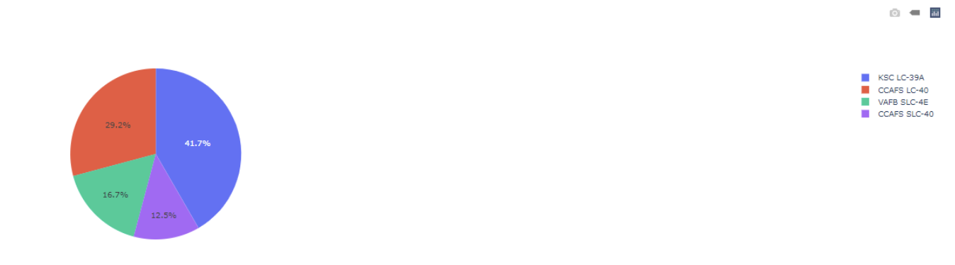
Launch Success Distribution Across SpaceX Sites
Shows how successful launches are distributed across SpaceX’s main sites.

Slide 40
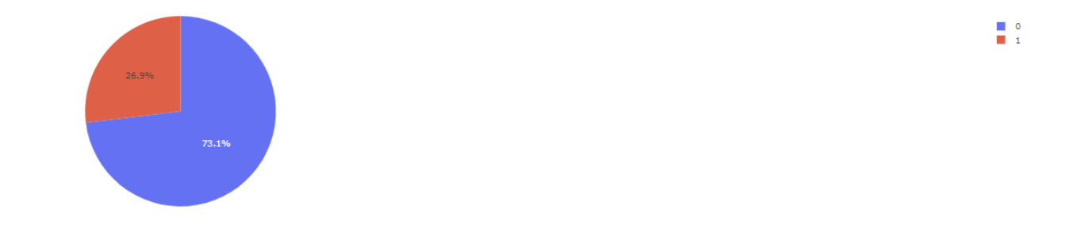
Launch Success vs Failure at CCAFS LC-40
Highlights why CCAFS LC-40 is SpaceX’s most reliable site (highest success ratio, strong reliability

Slide 41
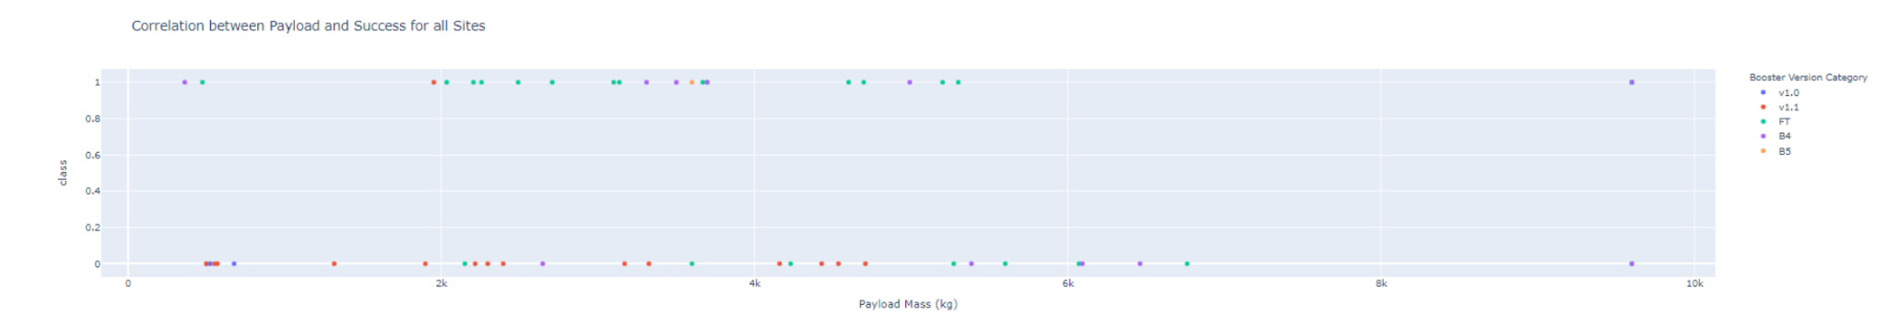
Payload vs Launch Outcome Across Sites
Certain booster versions (e.g., FT and B4) show more consistent successful landings at lower payloads (<5000 kg) and then after that its unsuccessful landings.

Slide 42

Section 5

Slide 43
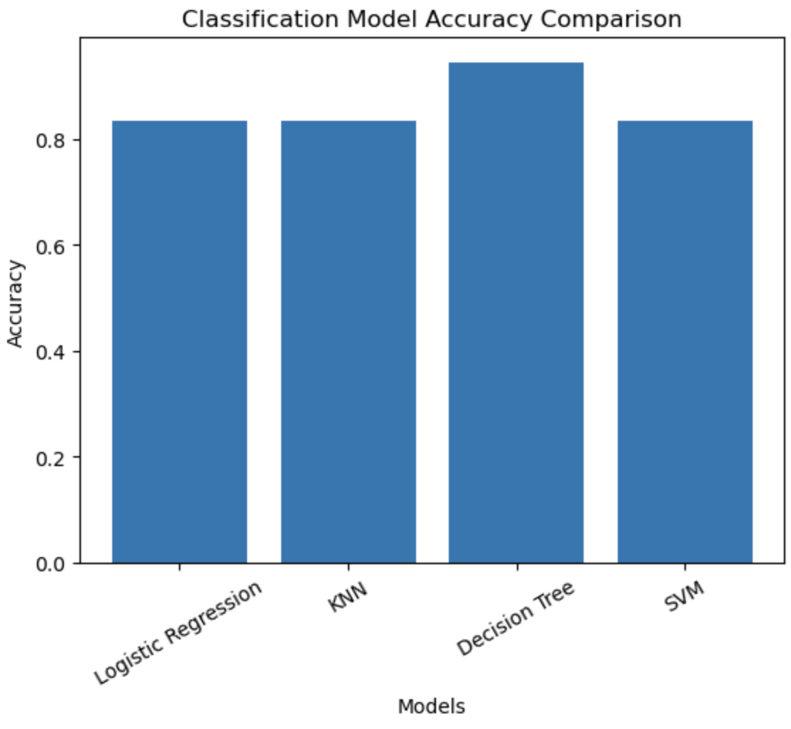
Classification Accuracy
The bar chart shows the accuracy of all classification models built.
Decision Tree achieved the highest accuracy (in this example 94%), making it the best-performing model.

Slide 44
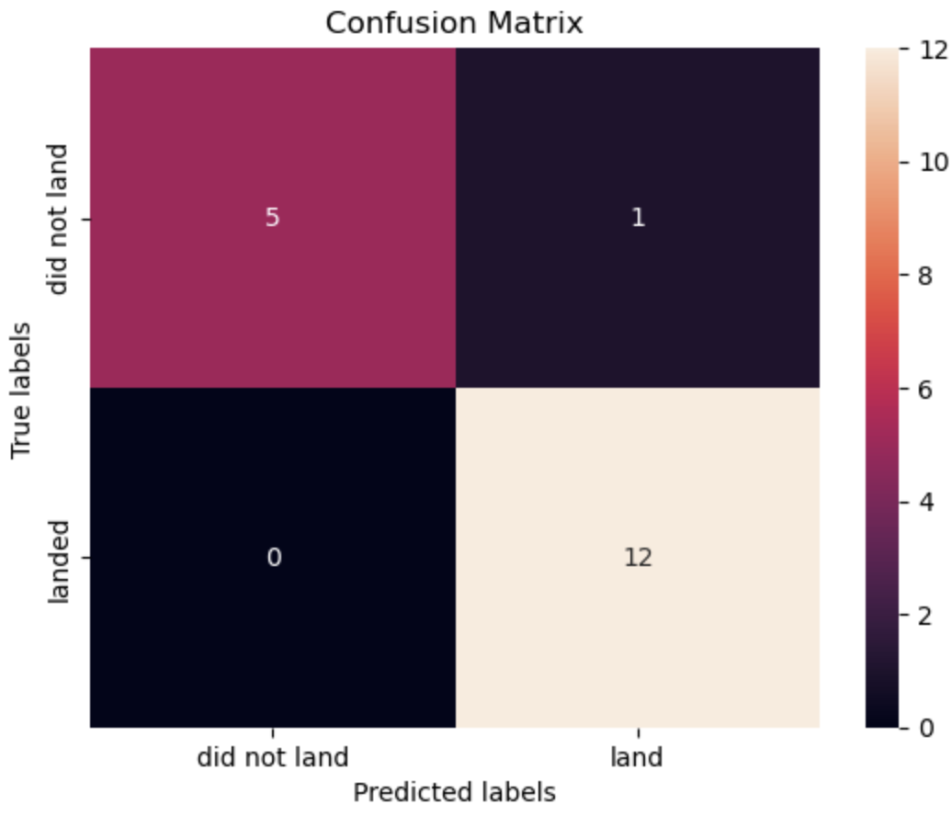
Confusion Matrix
The model performs very well, especially for predicting landings (100% recall for Land).
Only 1 misclassification happened, showing the model’s strong predictive power.
Overall, this confirms that the best performing classification model is highly accurate for the SpaceX landing prediction task.

Slide 45
Conclusions
Mission Success Trends: The dataset shows a clear increase in Falcon 9 successful landings over time, reflecting improvements in rocket reusability and launch technology.
Scatter Plot Insights: Payload mass and orbit type significantly influence landing outcomes.
Machine Learning Models: After hyperparameter tuning, Decision Tree achieved the highest predictive performance (94% test accuracy), outperforming Logistic Regression, SVM, and KNN (~83%).
Overall Finding: Both the EDA and ML results point to orbit type, payload mass, and launch site as the most critical features for predicting Falcon 9 first-stage landing success.

Slide 46
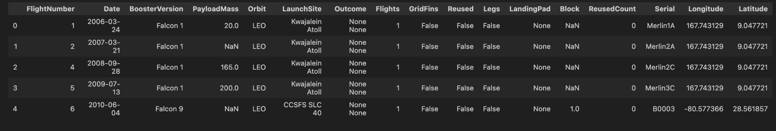
Appendix

Slide 47


